Slide 1


power consumption forecasting app using aws
-GROUP 1
SAJAN KUMAR KAR
SAIRAM VENKATACHALAM
SANIKA NARAYANPETHKAR

Slide 2


objective
The main objective is to harness AWS cloud infrastructure to develop a robust, scalable application for forecasting power consumption, focusing on analyzing and predicting energy usage patterns.
Aims to deliver analysis, predictive insights, and visualizations, capturing the complexities of power consumption across various zones and environmental conditions.
The dashboard leverages AWS technologies like EBS for application deployment, S3 for data storage, and QuickSight for data visualization, allowing users to examine power usage trends based on factors such as time, temperature, and humidity.

Slide 3

Data Source
Link
The data source used contains power consumption data from the city of Tetouan. This dataset will help us analyze patterns in power consumption, linked to the weather and time of day. We can then use these patterns to forecast future consumption, to help power grids manage energy demand in real time

Slide 4
Data Description
The data has the following features:
Date time: Time window of 10 minutes
Temperature: Weather temperature
Humidity- Weather Humidity
Wind speed: Speed of the wind
Diffuse Flows: It describes low-temperature (< 0.2° to ~ 100°C) fluids that slowly discharge through sulfide mounds, fractured lava flows, and assemblages of bacterial mats and macrofauna.
Zone1 Power Consumption (in KW)
Zone2 Power Consumption (in KW)
Zone 3 Power Consumption (in KW)

Slide 5

AWS SERVICES USED:
AWS S3: Hosts the raw used car transaction dataset.
AWS QuickSight: Provides the interactive dashboard using data and insights generated by Athena and predictive analytics.
AWS Elastic Beanstalk: Its used for deploying and scaling web applications and services. We can directly upload code and Elastic Beanstalk automatically handles the deployment—from capacity provisioning, load balancing, and auto scaling.

Slide 6






ARCHITECTURE:
S3
EBS
QUICKSIGHT
CLIENT

Slide 7
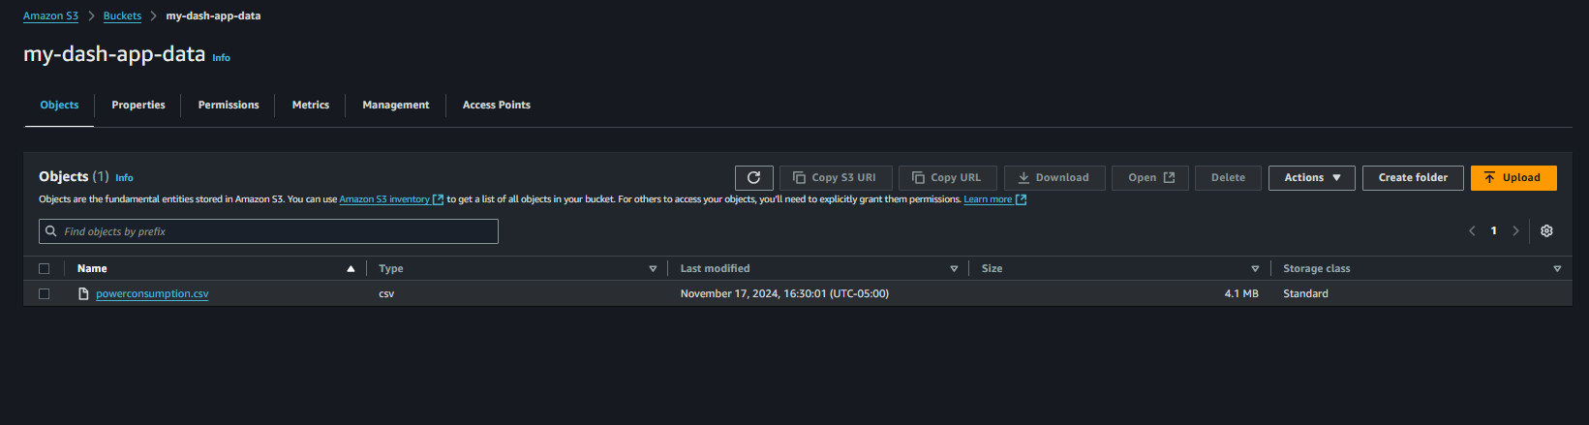
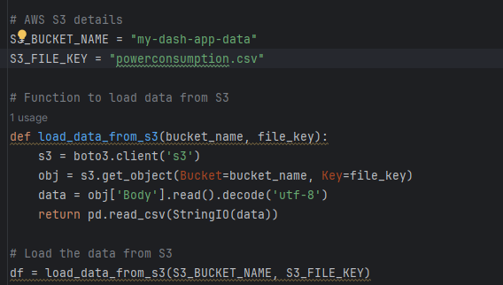
AWS S3(Simple, Secure, Storage):

Slide 8
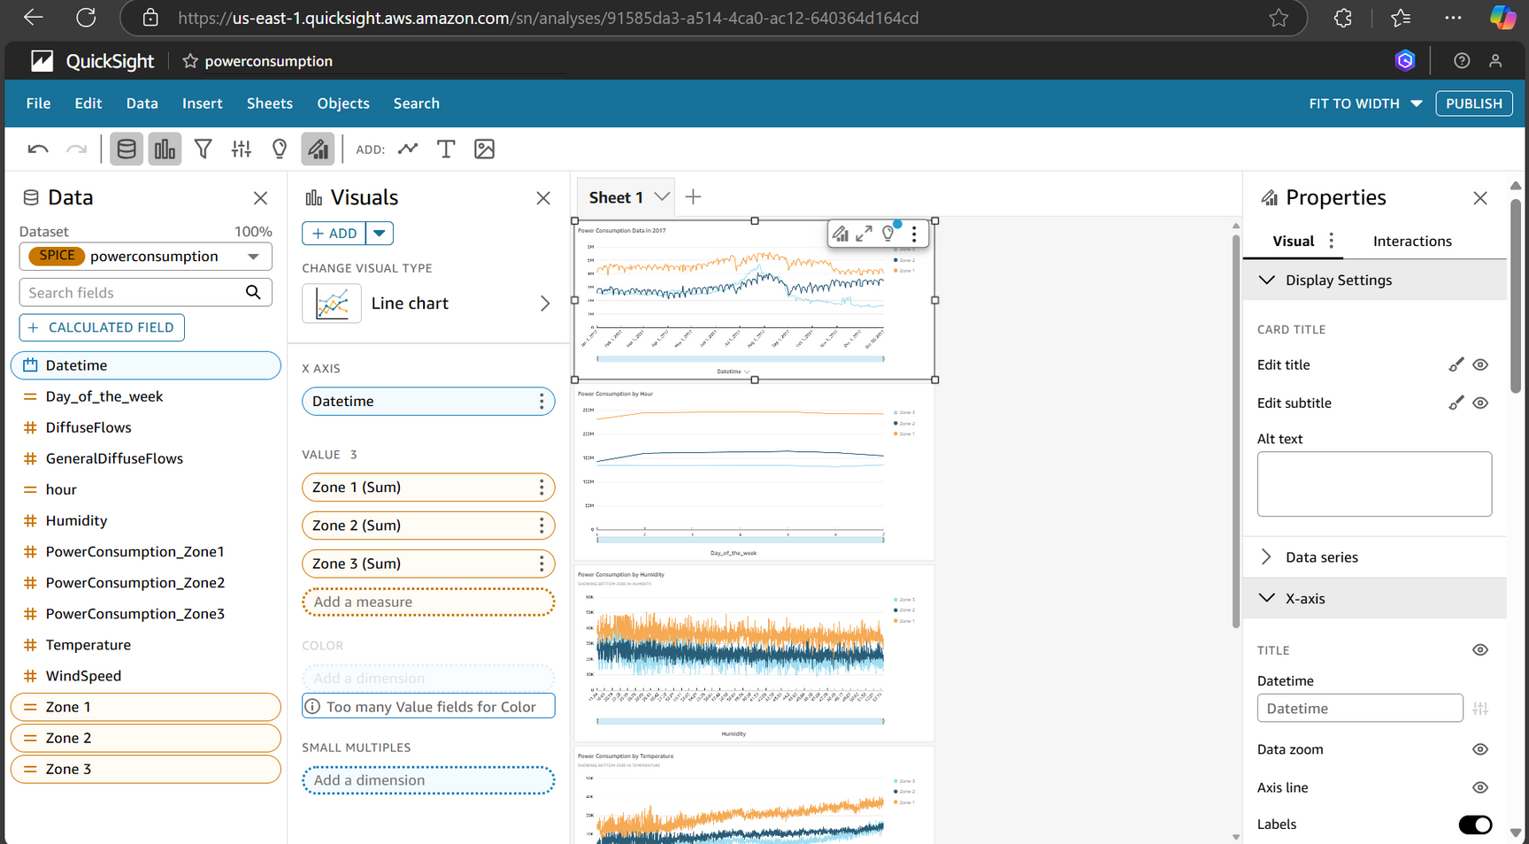
AWS QuickSight

Slide 9
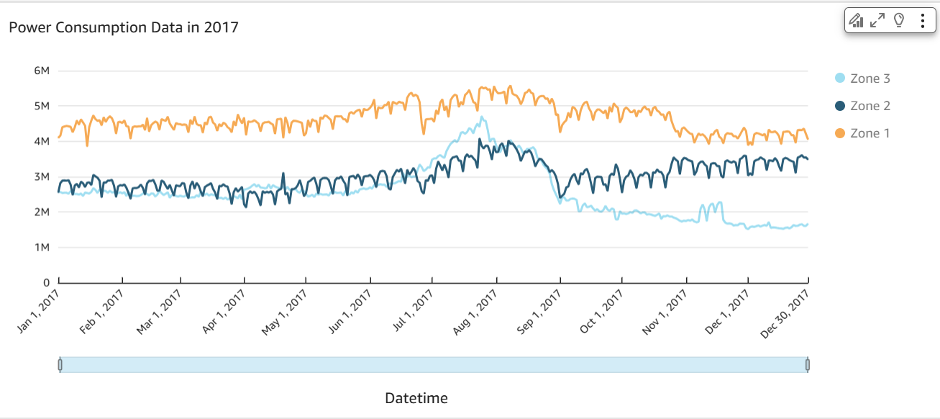
AWS QuickSight

Slide 10
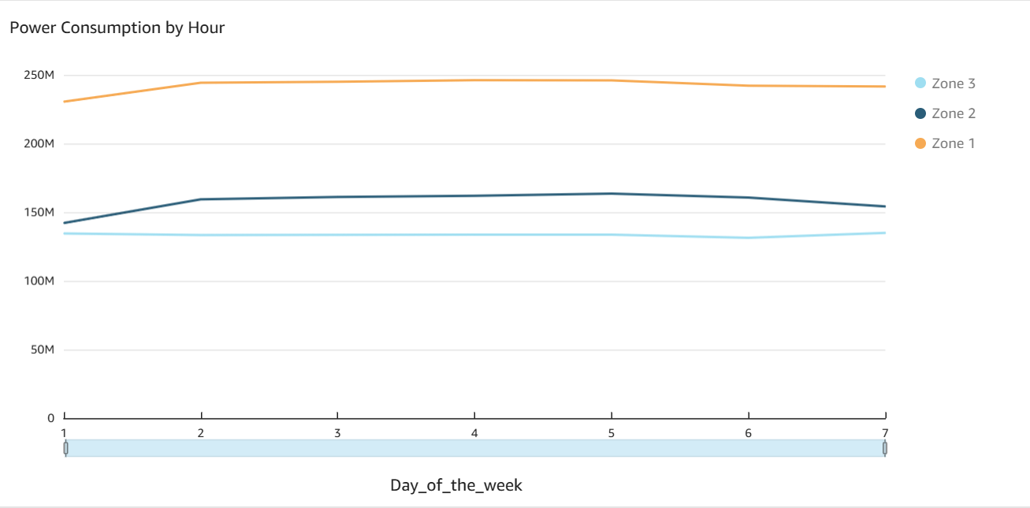
AWS QuickSight

Slide 11
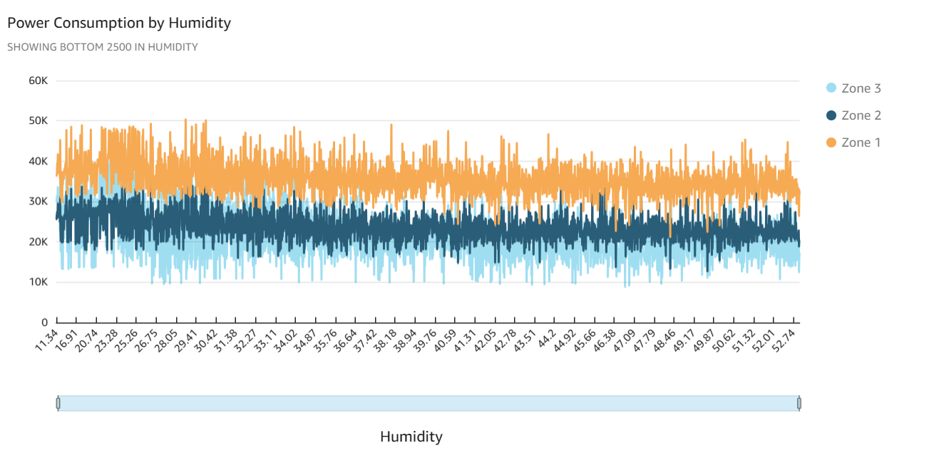
AWS QuickSight

Slide 12
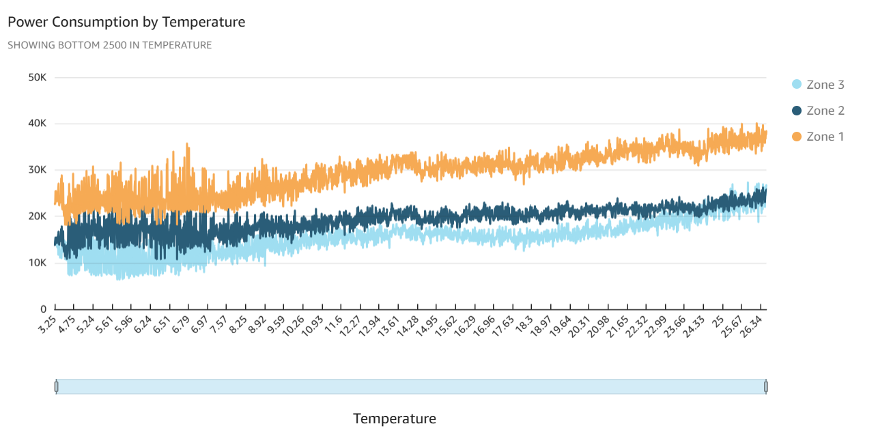
AWS QuickSight

Slide 13
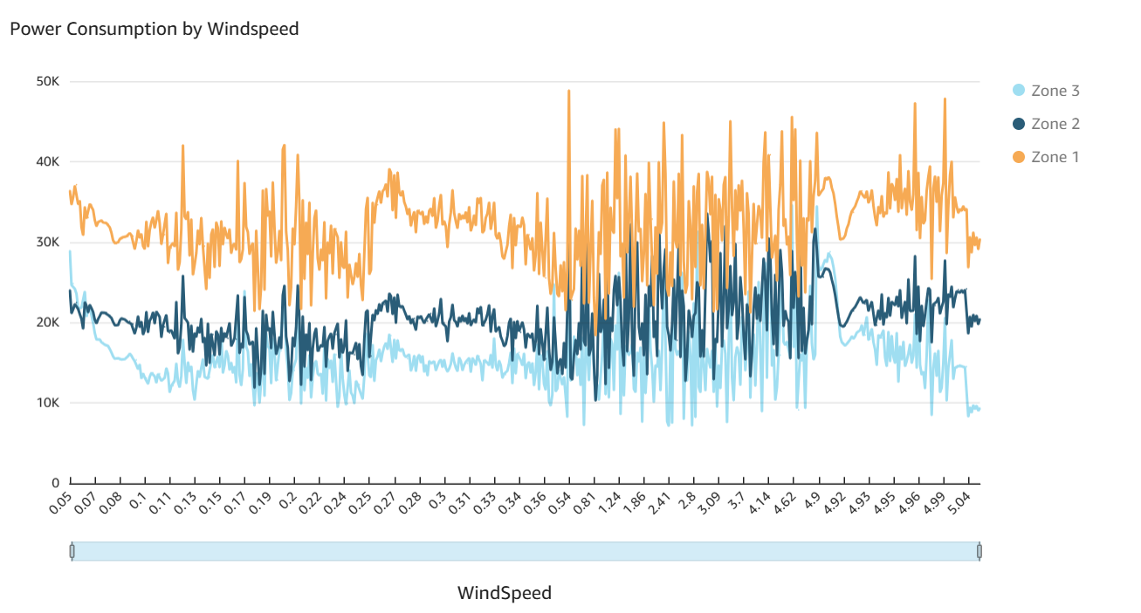
AWS QuickSight

Slide 14
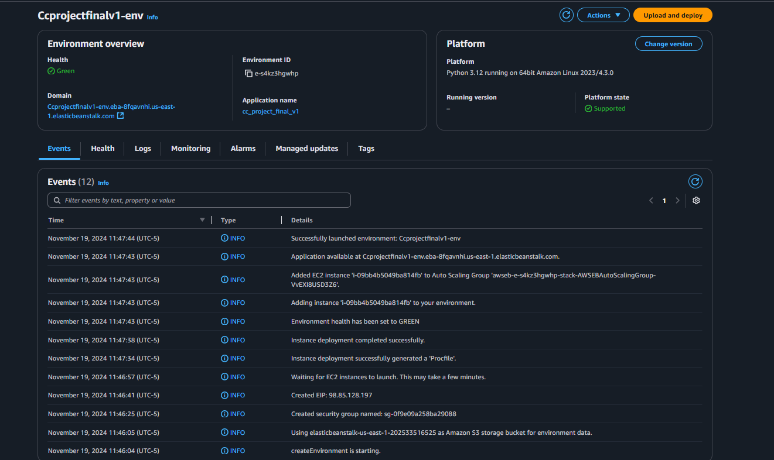
EBS Deployment:

Slide 15
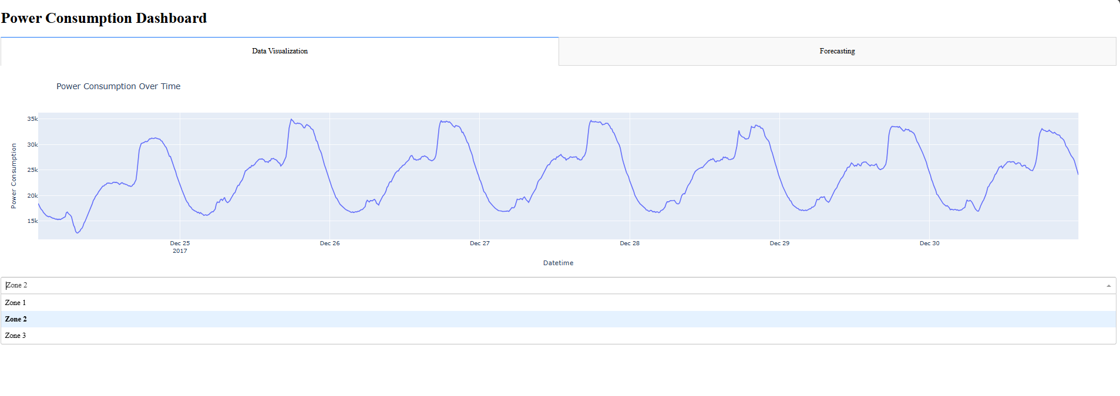
deployed app

Slide 16
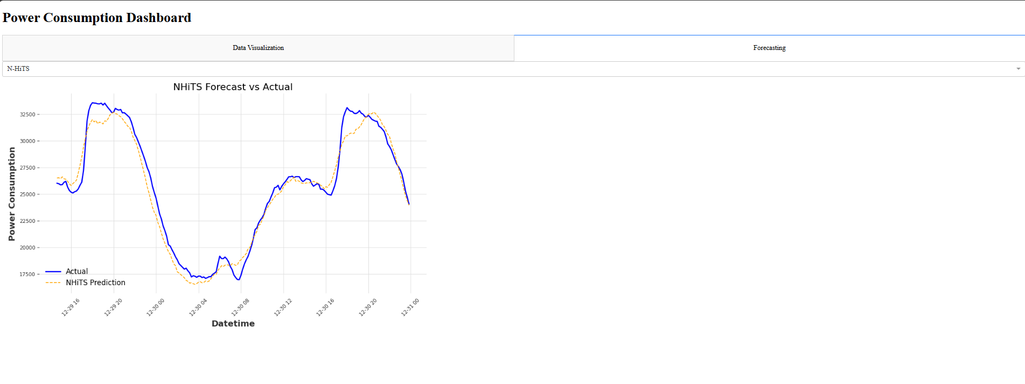
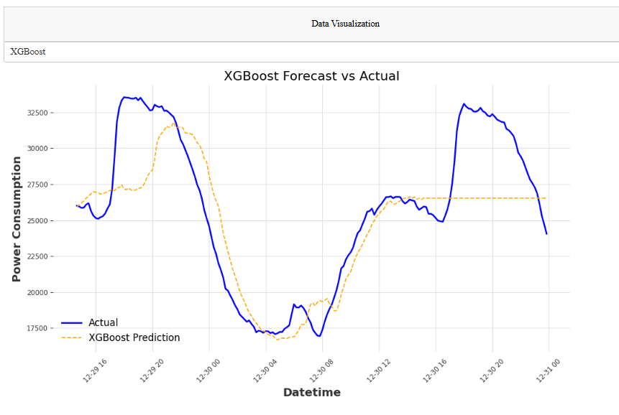
deployed app

Slide 17
REFERENCES
https://docs.aws.amazon.com/quicksight/
https://aws.amazon.com/elasticbeanstalk/
https://github.com/SairamVenkatachalam/Power-Consumption-Forecasting-App

Slide 18

Thank you very much!

